Slide 1

BATCH IN 2019

Slide 2
Safe Harbor Statement
The following is intended to outline the general direction of Pivotal's offerings. It is intended for
information purposes only and may not be incorporated into any contract. Any information
regarding pre-release of Pivotal offerings, future updates or other planned modifications is
subject to ongoing evaluation by Pivotal and is subject to change. This information is provided
without warranty or any kind, express or implied, and is not a commitment to deliver any
material, code, or functionality, and should not be relied upon in making purchasing decisions
regarding Pivotal's offerings. These purchasing decisions should only be based on features
currently available. The development, release, and timing of any features or functionality
described for Pivotal's offerings in this presentation remain at the sole discretion of Pivotal.
Pivotal has no obligation to update forward looking information in this presentation.

Slide 3

2019!

Slide 4

ANY REPLICANTS?

Slide 5


HOVERBOARDS OR FLYING CARS?

Slide 6
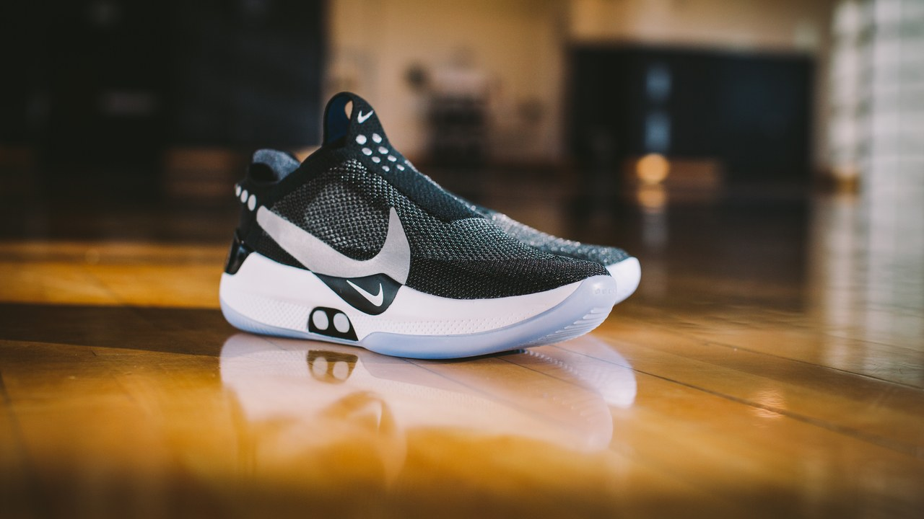
SELF LACING SHOES!

Slide 7
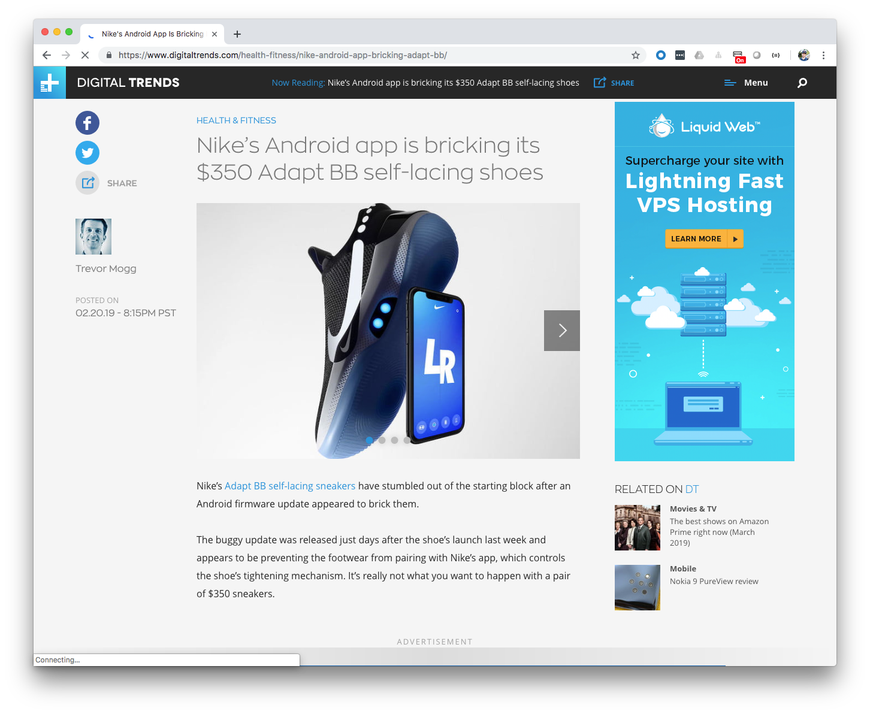

Slide 8

ALL THESE AMAZING THINGS
THE FUTURE HAS BROUGHT US…

Slide 9


Slide 10
고맙습니다!
شكرا لك.
Hvala vam!
Merci!
¡Gracias!
Dziękuję!
Благодарю!
धन्यवाद।
THANK YOU!
Danke!
Děkuju!
Grazie!
Sağol!
Obrigado!
Благодаря!
谢谢!

Slide 11


MICHAEL MINELLA
Lead – Spring Batch &
Spring Cloud Task
JSR-352 - Expert Group Member
Author – Pro Spring Batch
The D G to Spring Batch
Speaker - JavaOne Rockstar
Java Champion
Podcast - OffHeap Curmudgeon
Twitter - @michaelminella or
@OffHeap

Slide 12

COMING THIS SUMMER!
https://www.apress.com/us/book/9781484237236

Slide 13

http://www.javaoffheap.com/

Slide 14

SLIDES AND CODE
ARE ON GITHUB
https://github.com/mminella/Batch-In-2019
Notes:
S1P 2018 branch was used in the presentation at Spring One Platform 2018

Slide 15

Notes:
Please ask questions when you have them

Slide 16


LAY OF THE LAND

Slide 17

SPRING FRAMEWORK

Slide 18
SPRING BATCH

Slide 19

SPRING CLOUD DATA FLOW

Slide 20

MICROMETER

Slide 21

PROMETHEUS

Slide 22

GRAFANA

Slide 23
¯\_(ツ)_/¯

Slide 24

DAY IN THE LIFE OF
A BATCH DEVELOPER

Slide 25

GET OUR COFFEE

Slide 26

CHECK THE STATUS
OF THE EXISTING JOBS

Slide 27

ADD A NEW FEATURE

Slide 28

GO TO
PRODUCTION!

Slide 29

CHECK THE STATUS
OF THE EXISTING JOBS

Slide 30



Spring Batch/Spring Cloud Task
Push Gateway
Prometheus
Grafana
Spring Cloud Data Flow

Slide 31

ADD A NEW FEATURE

Slide 32
Step1
Step2
ItemReader
ItemProcessor
Tasklet
ItemWriter

Slide 33

GO TO
PRODUCTION!

Slide 34
Github
CircleCI
Spring Cloud Data Flow
Maven Repository

Slide 35

LOOKING AHEAD

Slide 36
SPRING BATCH 4.1.1.RELEASE

Slide 37
SPRING BATCH 4.2.0.M1

Slide 38
SPRING BATCH 4.2.0.RELEASE

Slide 39

PERFORMANCE

Slide 40
METRICS VIA
MICROMETER

Slide 41
SPRING CLOUD DATA FLOW 2.0!

Slide 42
ANALYTICS VIA
MICROMETER
Notes:
Apps have support for Prometheus, InfluxDB, and Data Dog

Slide 43
REVAMPED METRICS
VIA MICROMETER

Slide 44

SECURITY
IMPROVEMENTS

Slide 45

DASHBOARD
IMPROVEMENTS

Slide 46
DATABASE MIGRATION
SUPPORT

Slide 47

MULTIFOUNDATION
SUPPORT FOR TASKS

Slide 48
Notes:
Please ask questions when you have them

